Slide 1
Memory Hierarchy
Bojian Zheng
CSCD70 Spring 2018
bojian@cs.toronto.edu

Slide 2
Memory Hierarchy
From programmer’s point of view, memory
  has infinite capacity (i.e. can store infinite amount of data)
  has zero access time (latency)
But those two requirements contradict with each other.
  Large memory usually has high access latency.
  Fast memory cannot go beyond certain capacity limit.
Therefore, we want to have multiple levels of storage and ensure most of the data the processor needs is kept in the fastest level.

Slide 3
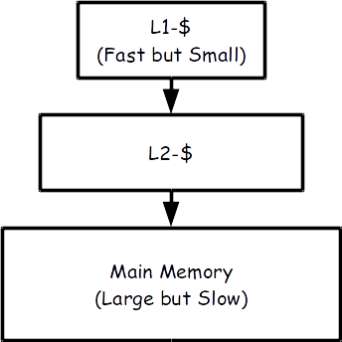
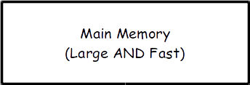
Memory Hierarchy
What in reality
What we see (Ideally)

Slide 4
Locality
Temporal Locality: If an address gets accessed, then it is very likely that the exact same address will be accessed once again in the near future.
unsigned a = 10;
…
// ‘a’ will hopefully be used again soon

Slide 5
Locality
Spatial Locality: If an address gets accessed, then it is very likely that nearby addresses will be accessed in the near future.
unsigned A[10];
A[5] = 10;
…
// ‘A[4]’ or ‘A[6]’ will hopefully be used soon

Slide 6
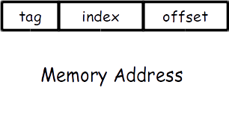
Cache Basics
Memory is divided into fixed size blocks. Each block maps to one location in the cache (called cache block or cache line), determined by the index bites.

Slide 7
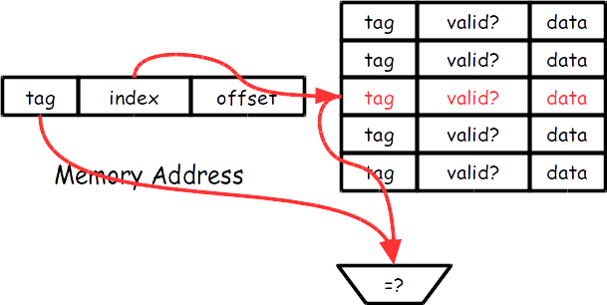
Direct-Mapped Cache

Slide 8

Direct-Mapped Cache: Problem
Suppose that two variables A (address 0’b10000000) and B (address 0’b11000000) map to the same cache line. Interleaving accesses to them will lead to 0 hit rate (i.e. A->B->A->B->…).
Those are called conflict misses (more later).

Slide 9
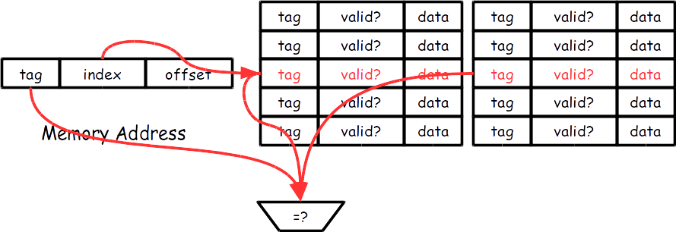
Set-Associative Cache

Slide 10
Set-Associative Cache: Problem
More expansive tag comparison.
More complicated design – lots of things to consider:
  Where should we insert the new incoming cache block?
  What happens when a cache hit occurs? How should we adjust the priorities?
  What happens when a cache miss occurs, and the cache set has been fully occupied (Replacement Policy)?

Slide 11
Replacement Policy
Which one to evict under the condition that the cache set is full?
  Least-Recently-Used?
  Random?
  Pseudo-Least-Recently-Used?
Belady’s (a.k.a. Optimal) Replacement Policy
  Evict block that will be reused furthest in the future.
  Impossible to implement in hardware … why?
  But is still useful … why?

Slide 12
Cache Misses
There are 3 types of cache misses:
  Cold Misses: happens whenever we reference one variable (memory location) for the first time. Such misses are unavoidable (???).
  Capacity Misses: happens because our cache is too small.
    Misses that happen even under fully-associative cache and optimal replacement policy.
    Cache size is smaller than working set size.
  Conflict Misses: happens because we do not have enough associativity.

Slide 13
Handling Writes
Write-Back vs. Write-Through
  Write-Back: Write modified data to memory when the cache block is evicted.
    (+) Can effectively combine multiple writes to the same block.
    (-) Needs an extra bit indicating dirty or clean.
  Write-Through: Write modified data to memory whenever write occurs.
    (+) Simple and makes it easy when arguing about consistency.
    (-) Cannot combine writes and is more bandwidth intensive.

Slide 14
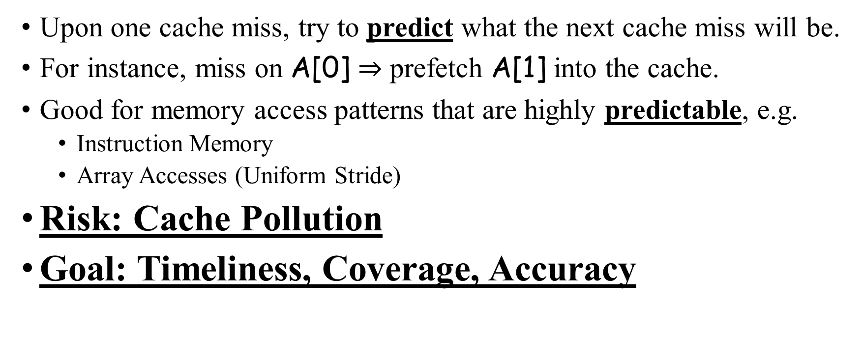
Prefetching
Upon one cache miss, try to predict what the next cache miss will be.
For instance, miss on A[0] $⇒$ prefetch A[1] into the cache.
Good for memory access patterns that are highly predictable, e.g.
  Instruction Memory
  Array Accesses (Uniform Stride)
Risk: Cache Pollution
Goal: Timeliness, Coverage, Accuracy

Slide 15
Questions?
Cache Basics
  Cache
  Locality
  Set-Associativity
    Replacement Policy
Cache Misses
  Cold
  Capacity
  Conflict
Handling Writes
  Write-Back
  Write-Through
Prefetching
  Risk
  Goal

Slide 16
Preview: Cache & Compiler
Ok … So how this is related to compiler?
unsigned A[20][10];
for (unsigned i = 0; i < 10; ++i)
for (unsigned j = 0; j < 20; ++j)
A[j][i] = j * 10 + i; // Assume A is row-major.
This is not very nice … because cache has been utilized badly : (

Slide 17



Preview: Cache & Compiler
for (i $∈\left[0, 10\right)$)
for (j $∈\left[0, 20\right)$)
A[j][i] = j * 10 + i;
for (j $∈\left[0, 20\right)$)
for (i $∈\left[0, 10\right)$)
A[j][i] = j * 10 + i;

Slide 18
Preview: Cache & Compiler
Consider another example:
unsigned A[100][100];
for (unsigned i = 0; i < 100; ++i)
for (unsigned j = 0; j < 100; ++j)
sum += A[i][j]

Slide 19
Preview: Cache & Compiler
Apply prefetching:
unsigned A[100][100];
for (unsigned i = 0; i < 100; ++i)
for (unsigned j = 0; j < 100; j += $_BLOCK_SIZE)
for (unsigned jj = j; jj < j + $_BLOCK_SIZE; ++jj)
prefetch(&A[i][j] + $_BLOCK_SIZE)
sum += A[i][jj]

Slide 20
Preview: Design Tradeoff
Consider the following code:
unsigned A[20][10];
for (unsigned i = 0; i < 10; ++i)
for (unsigned j = 0; j < 19; ++j)
A[j][i] = A[j+1][i];

Slide 21


Preview: Design Tradeoff
Loop Parallelization
Cache Locality
for (i $∈\left[0, 10\right)$)
for (j $∈\left[0, 19\right)$)
A[j][i] = A[j+1][i];
for (j $∈\left[0, 19\right)$)
for (i $∈\left[0, 10\right)$)
A[j][i] = A[j+1][i];

